Slide 1
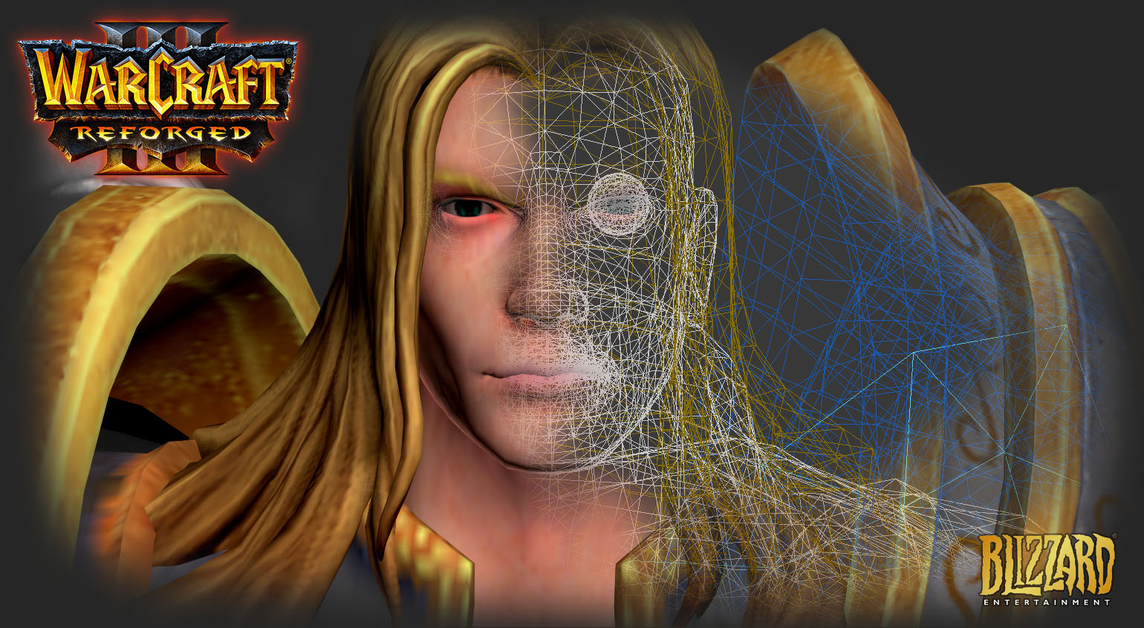

Slide 2
© 2021 Blizzard Entertainment. All rights reserved. Reign of Chaos, The Frozen Throne and the Warcraft Art Tools logos are trademarks, and Warcraft and Blizzard Entertainment are registered trademarks of Blizzard Entertainment. Windows is a trademark or registered trademark of Microsoft Corporation in the U.S. and/or other countries. 3ds max is a trademark or registered trademark of Autodesk, Inc. Adobe and Photoshop are either registered trademarks or trademarks of Adobe Systems Incorporated in the United States and/or other countries.
This is meant as a hobby project and NOT for making profit or any kind of money!

Slide 3
Introduction
Thank you for downloading my Warcraft III Reforged Tools for 3D Studio Max.
System requirements
You must have a valid 3D Studio Max 2011 or above license, student license or trial license. The scripts have been created with 3D Studio Max 2016 on a Windows 10 Pro x64 (19042.804 build) and tested up to 3D Studio Max version 2020.
Note:
this is a work in progress and is not officially supported by Blizzard. Check the github page often for updates!

Slide 4
Installation

Slide 5
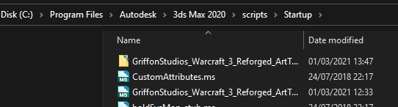
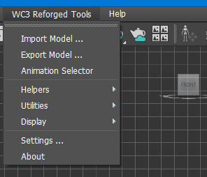
Installation
Installation
Download the latest scripts from my github page: Taylor Mouse’s Github Page
You can download everything, or just the scripts you need for WC3Reforged.
You need at least the GriffonStudios_Warcraft_3_Reforged_Tools folder (and content) and then GriffonStudios_Warcraft_3_Reforged_Tools.ms script.
Once downloaded, copy the .ms file and the folder in your scripts/Startup folder of 3D Studio Max.
Example Max 2016:
Run 3D Studio Max and an additional Menu will be available.

Slide 6
Tools & Plugins

Slide 7
Tool & Plugin Description
Import Model
Export Model
Animation Selector
Helpers
Ribbon
Event
Face FX
Attachment
Particle Emitter
Popcorn FX
Utilities
NOTE: utilities only possible if the official Starcraft II
Art Tools are installed ( Max 2011 & Max 2016 )
Reset Animation Tracks
Display
Collapse Hit Tests
Expand Hit Tests
Collapse Attachment Points
Expand Attachment Points
Settings
Warcraft 3 Reforged Standard Material
Each of these tools & plugins are described next

Slide 8

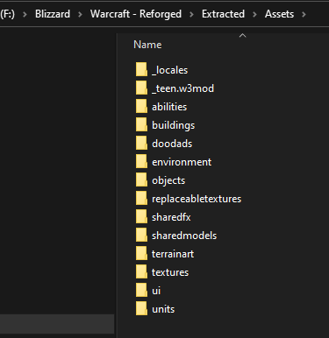
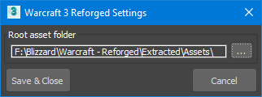
Settings
Make sure you extracted all the assets from the game. To achieve this, I use the Casc Storage Explorer.
Download Casc Storage Explorer
The export folder looks like this and is essential to
import everything correctly in 3DS Max.
Open the Settings from the menu and select the assets folder
where you exported everything:
Note: this step is only required once

Slide 9
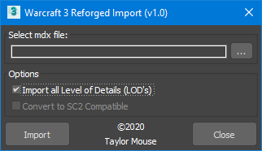
Import model
Select Import model … from then menu.
Select the mdx file you want to import by pressing the ellipsoid button (…)
LOD’s:
By default this is not checked, almost all models have different Level of Details in the model. This could take some time to import, so you can uncheck if you prefer not to import them.
Convert to SC2 Compatible
If the purpose is to export it later to Starcraft II using the Art Tools, you need a valid version of Max with the Art Tools installed. If they are not available, the checkbox is disabled else check or uncheck it.
Import
Imports the selected model, if any error may occur, please let me know. You can also open the listener (F11) and take a look what the error is.

Slide 10
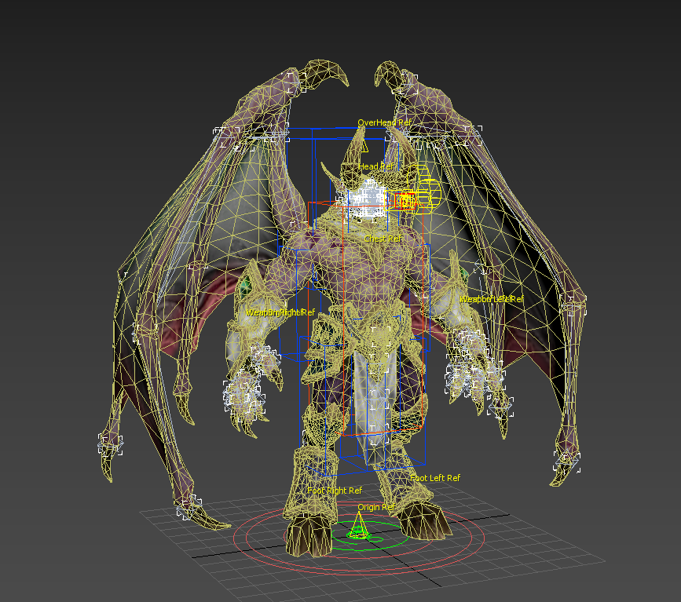
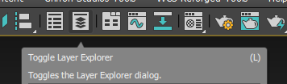
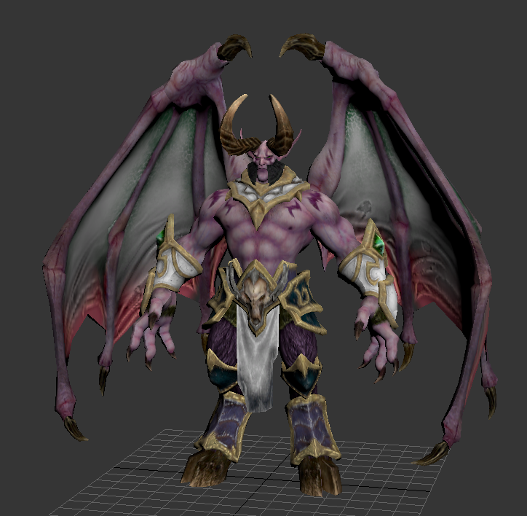
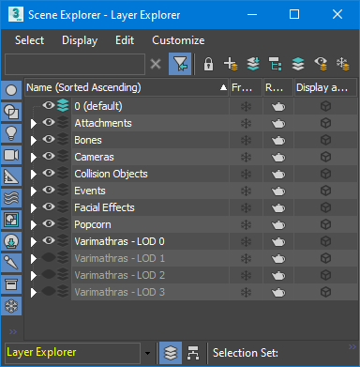
Example import
If everything went well, Varimathras.mdx looks like this
Go to the Layer Manager to turn them on or off for better visualizing the model.
I mapped it to the (L) hotkey.

Slide 11
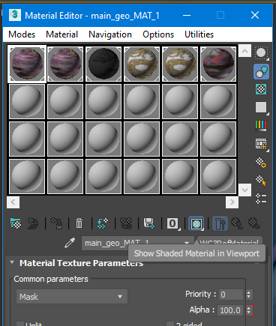
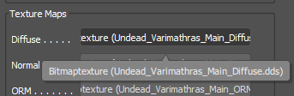
Issues after import
No textures are shown
Open the material editor ( shortcut M )
If this is the Slate Material Editor, you can change the Mode to Compact in the Modes menu.
Check the “Show Shaded Material in Viewport”
Still no textures are showing
Press the Diffuse Texture Map, then select the bitmap, finally select the texture that is required ( usually pressing tab does the trick )

Slide 12
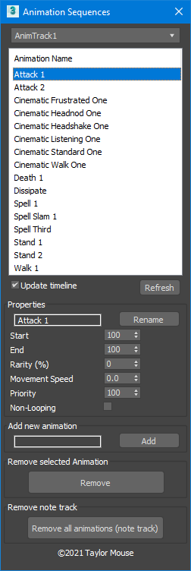
Animation Selector
Open the Animation Selector from the WC3 Reforged Tools menu
Animation Tracks
Some models have overlapping animation sequences, they can be found in the Animation Tracks drop down. ( Varimathras has 2 )
Update timeline
When this is checked the animation track bar at the bottom will be adjusted to the correct start and end frame of the animation sequence
Refresh
Refreshes the list of animations
Rename
You can change the name of the animation by first selecting it, changing the name, and pressing the Rename button
Properties
After selecting an Animation, it will fill the properties, changing them will update these properties
Add New Animation
Fill in the properties, and a name for the new animation, then press the add button
Remove selected animation
This removes the selected animation, but NOT the keys and frames of the animated objects in the scene
Remove note track
Removes ALL animations and animation note tracks, does NOT remove the keys and animations of the animated objects
NOTE: the sequence animations are set up to be compatible with SC2 notes, so the Animation selector can be used for Starcraft II as well.

Slide 13
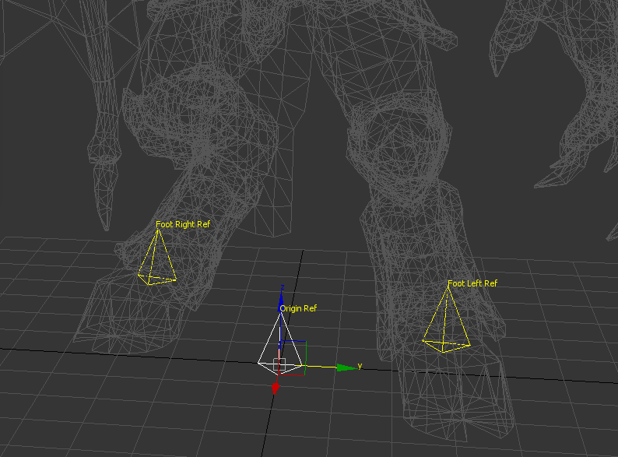
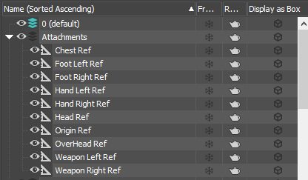
Attachments
Go to WC3 Reforged Tools -> Helpers menu and select Create Attachment
An attachment will be created in the scene at position [0,0,0]
Select it and rename it
No additional properties are required
An attachment cannot be animated, to animate it, create a separate bone for it and link the attachment to the bone using the “Select and link” tool in 3DS Max.
Please refer to the official Warcraft III Art Tools documentation.pdf page 22 (Appendix B) for a full list of supported names
Example from the Varimathras model

Slide 14

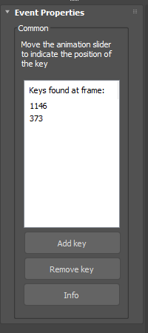
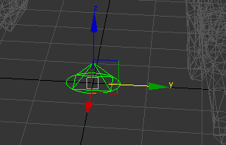
Events
Go to WC3 Reforged Tools -> Helpers menu and select Create Event
An event object will be created in the scene at position [0,0,0]
Select it and rename it
Selecting the event brings up an additional property window where you can add the keys when the event will happen ( when means, on what frame )
Move the animation trackbar (at the bottom ) to the required key and press the add key to add it in the list
In the example, the FPTxFCL1 event is selected and has 2 keys ( 1146 & 373 ) at these frame, this event will happen.
An event cannot be animated
Please refer to the official Warcraft III Art Tools documentation.pdf
(Appendix C to F) for a full list of supported names
Footprints | FPTxyyyy | Appendix C
Blood splats | SPLxyyyy | Appendix C
Uber Splat | UBRxyyyy | Appendix D
Sound Events | SNDxyyyy | Appendix E
Spawn Objects | SPNxyyyy | Appendix F

Slide 15
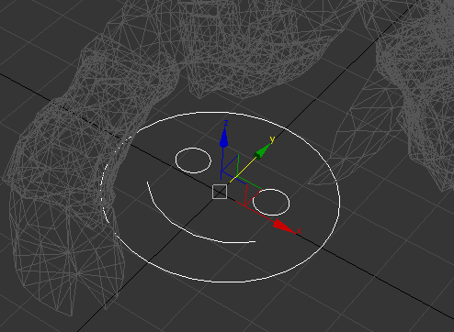

Facial Effects (FX)
Go to WC3 Reforged Tools -> Helpers menu and select Create Face FX
An WC3RefFaceFx object will be created in the scene at position [0,0,0]
It allows the usage of facial effects of the model. However it is nothing more then a reference to the .facefx file
Usually only one .facefx file is used and is called “Node”
In 3DS Max the FaceFX plugin looks like a smiley with a parameter pointing to an external .facefx file
NOTE: at the time or writing no research is done in unravelling the content of the file ( probable contains animations linked to the facial bones )

Slide 16
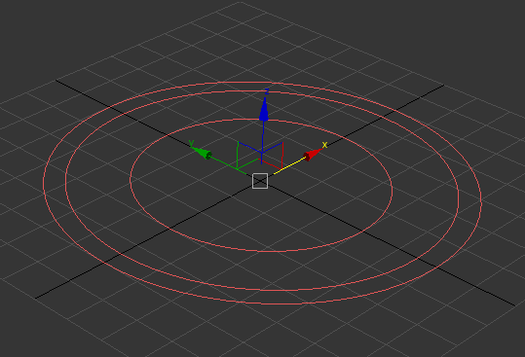
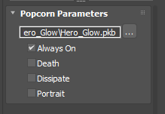
PopcornFX
Popcorn FX is a multi platform real time effects solutions for particle effects.
You can read more about it here: https://www.popcornfx.com/
Although the website allows you do download their Editor, it is, at this moment, impossible to import the popcornfx files from WC3 Reforged.
Go to WC3 Reforged Tools -> Helpers menu and select Create Popcorn FX
A WC3RefPopCorn object will be created in the scene at position [0,0,0]
You can animate the object’s transform
You can animate the object’s visibility ( on or off )
The properties reference an external .pkb file and a propery when to display the effect.

Slide 17
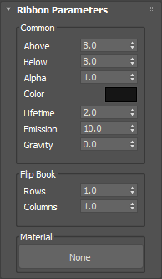
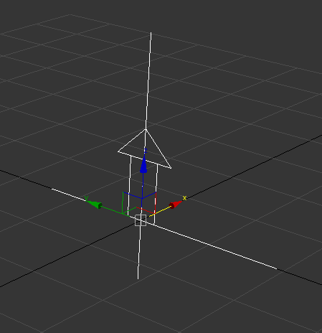
Ribbon Emitter
Go to WC3 Reforged Tools -> Helpers menu and select Create Ribbon
An attachment will be created in the scene at position [0,0,0]
See the official Warcraft 3 Art Tools Documentation.pdf for detailed description
Parameters
Above & Below: define the width of the object, above and below the center of the object.
Alpha: fixed alpha value of the emitted particles
Color: fixed color of the emitted particles
Lifetime: number of seconds the particle stays alive ( Edge Life )
Emission: number of particles that are emitted in total ( Edges/sec )
Gravity: sink or raise the particles additionally
Flipbook Rows & Columns: using a texture that has a particle strip, identifying the number of rows and columns in the texture
Material: create a WC3 Standard Material first and select this to apply the material.

Slide 18
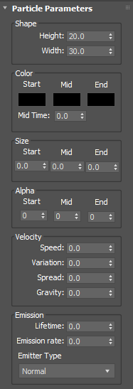
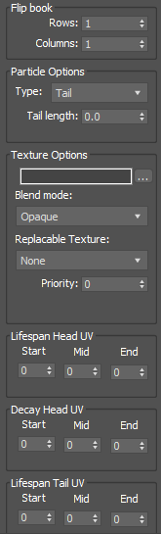
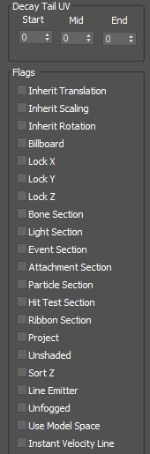
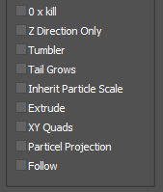
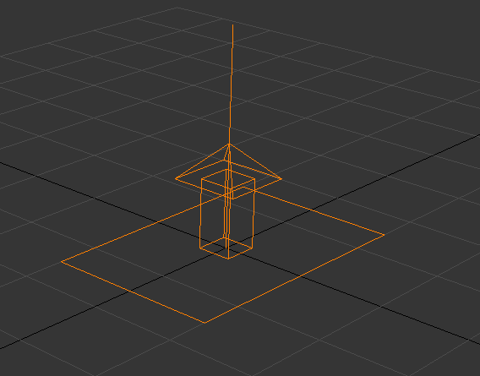
Particle Emitter
Go to WC3 Reforged Tools -> Helpers menu and select Create Particle Emitter
An attachment will be created in the scene at position [0,0,0]
See the official Warcraft 3 Art Tools Documentation.pdf for a full detailed description
( page 12 – 14 )

Slide 19

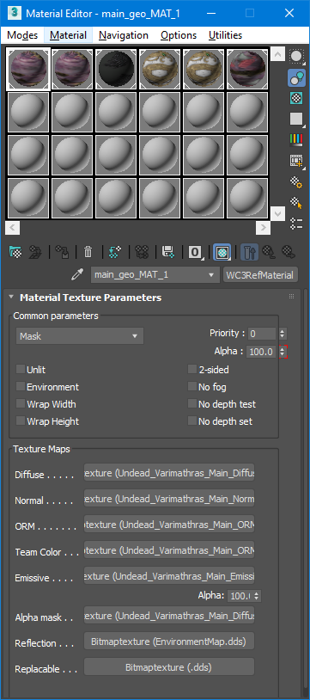
Material
Open the Material editor ( press M ), select a material slot and change the Standard type to a Warcraft 3 Reforged Standard material
Warcraft III Reforged supports PBR material ( Physical Based Rendering )
Parameters
Draw mode
Opaque: model is drawn solid
Mask: the transparent alpha mask map is used
Blend: depth set is turn off
Add: additive drawing, has a ghost effect mode
BlendAdd: both blend and additive is used
Mod: make the semi transparent darken the background, opacity has no effect
Mod2x: depth is turned off, no sort order error
Unlit: no light effect are used, giving a flat texture look
2-sided: backface culling is not used, drawing both sides of a polygon
No fog: model ignores the darkening of the distant fog
No depth set: the model’s polygons are not written to the depth buffer
No depth test: the model’s polygons will not test the sort order from the depth buffer
Alpha: can be animated to make the model transparent
Priority: prioritizes the writing to the depth buffer
Wrap Width & Height: allows texture tiling in the horizonal and vertical axis
Environment: specifies if the model is impacted by the reflection of the environment map
This material is constructed of the following types of maps, each map type is explained in the next pages
Diffuse map ( is more an albedo map )
Normal map
ORM map
Team Color map
Emissive map & Emissive Alpha ( strength of the emission )
Alpha mask map
Reflection map
Replaceable map

Slide 20
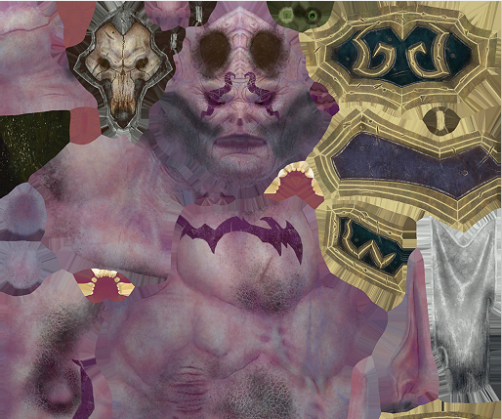

Diffuse map
The diffuse map ( should be called albedo map ) should not contain any light information, only color information
The alpha channel contains the transparent information and is used in the Alpha Mask map
DXT5 .dds image type ( the texture shown, is just a piece of it, not the whole texture)

Slide 21
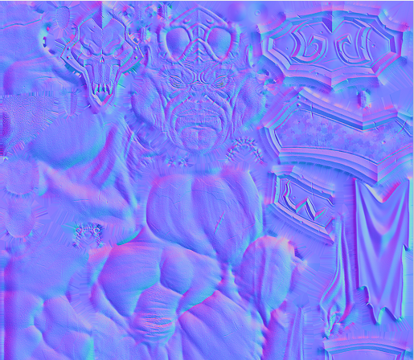
Normal map
Note, this type of texture cannot be read by 3D Studio Max so first save it as a DXT1 .dds image, select it in max, then convert it to a ATI2N .dds image.
Alpha channel is white
Blue channel is white
R & G are the channels used for the normal map
If you want to create an empty normal map, take the rgb colors 128 128 255.

Slide 22
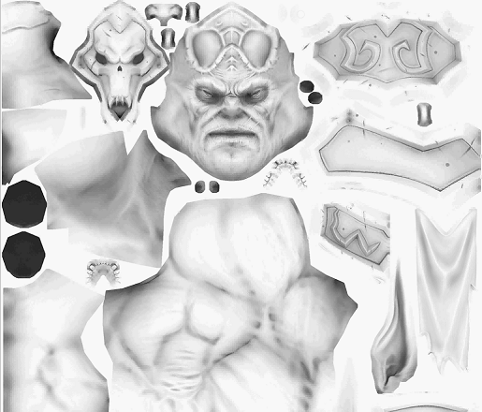
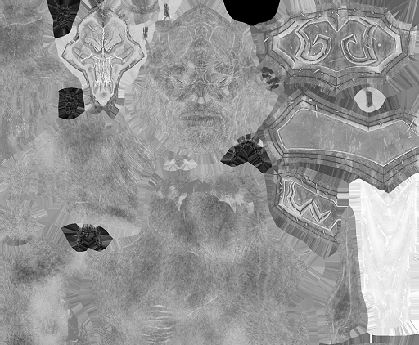
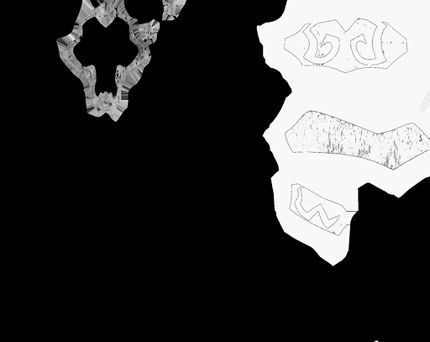

ORM Map
The ORM map stands for occlusion roughness and metal reflection and the alpha channel holds the team color alpha map
Use white for full metal reflection and black for no metal reflection.
Use white for no shadow and black for full shadow in the ambient occlusion
Use black for no roughness, white for full roughness, mostly this is grey’ish
Use white for team color and black for no team color, in the diffuse map, keep the team color parts white
DXT5 .dds image type
R channel : Ambient Occlusion
G channel : Roughness
B channel : metal reflection
A channel : team color

Slide 23
Team color map
This slot uses the alpha of the selected texture, this is usually the ORM map ( see previous page )
If this slot is empty, no team color is used

Slide 24
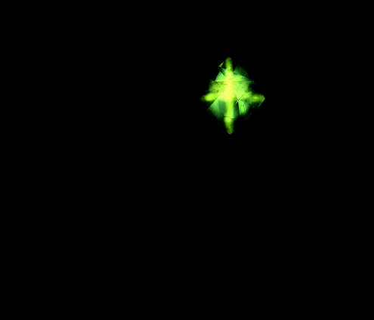
Emissive Map
An emissive map is a texture that is used to make certain parts glow.
This can be a color texture.
The emissive alpha parameter is used to make it more or less glow.
Example:
for Varimathras’s pouldrons, there is a emissive map.
The black parts do not emit anything, where the green will give a nice glow in the game
DXT1 .dds image type

Slide 25
Alpha mask map
The alpha mask comes from the alpha layer of the diffuse map
White -> everything is drawn
Black -> nothing is drawn
Everything is between has a cutoff alpha value of 16

Slide 26
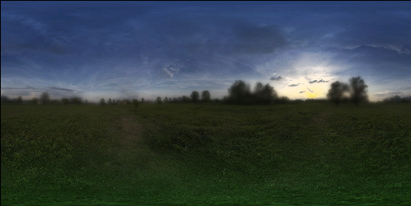
Reflection map
A reflection map is used to add as a reflection on the metal and roughness map
It is a cubical or spherical map the emulates the surroundings
For Warcraft III Reforged, the most common map used it’s the EnvironmentMap.dds

Slide 27
Replaceable map
Can be a specific color map used as a team color
Up till now, no map has been found in here and is always a specific type, which makes me believe it is not a map but a dropdown with specific values?
Texture ID’s
None
Team Color
Team Glow
Trees
For more information about Replaceable texture ID’s please see page 20 in the official Warcraft III Art Tools Documentation.pdf

Slide 28
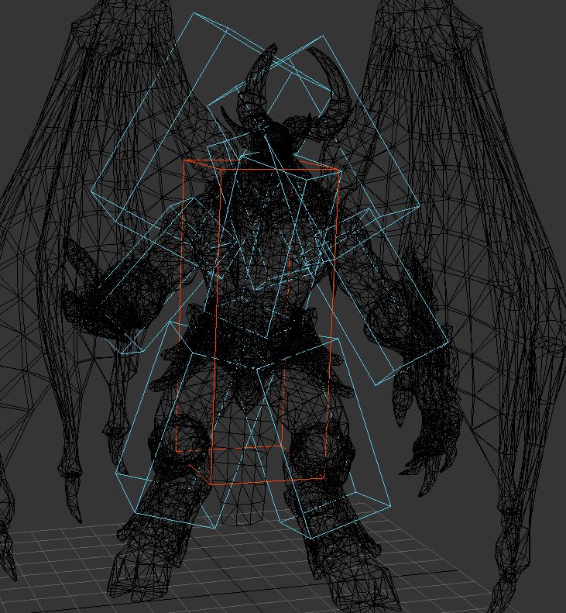
Collision Objects
These objects come in 2 flavors, boxes and spheres
However I believe they are build using a capsule algorithm ( height + radius ) for the sake of saving space ( 2 floats max in stead of 6 )
The red one is the root collision object (always called that )
The blues are the additional collision objects
A collision object always starts with the prefix
B_KGS_
There must always be ONE B_KGS_ROOT object
These objects must be attached to a bone for export
In the mdx, these objects are not linked to a bone but have their own animation keys

Slide 29
Exporter

Slide 30
Under construction

Slide 31
Appendix

Slide 32
Interesting url’s
My Github page
Official Starcrat II Art Tools
SC2ArtTools2016.zip
My Modded models
Autodesk 3D Studio Max
Casc Storage Explorer (Required to open Blizzard archive game files)
Warcraft III Art Tools Documentation.pdf

